Slide 1
Online Quiz System
Done by:
Vaishnavi Gursal

Slide 2
Concepts Used
Servlets
JSP operations
Session Handling
Filters

Slide 3
Important pages
StudentRegistrationServlet: Where student can register and details get store in database
TeacherRegistrationServlet: Where teacher can register and details get store in database
StudentLoginServlet : Student can login if already registered.
TeacherLoginServlet : Teacher can login if already registered.
Validation Filters - ( Used for above files )
WelcomeExam.jsp : For choosing test.
Takeexam.jsp : Taking Test
ExamServlet : For calculating score
CreateQuesServlet : Teacher can create quiz
SelectQuestions.jsp :Teacher can view all questions.
WelcomeData : Teacher can see Name and Marks of student who appeared test.

Slide 4
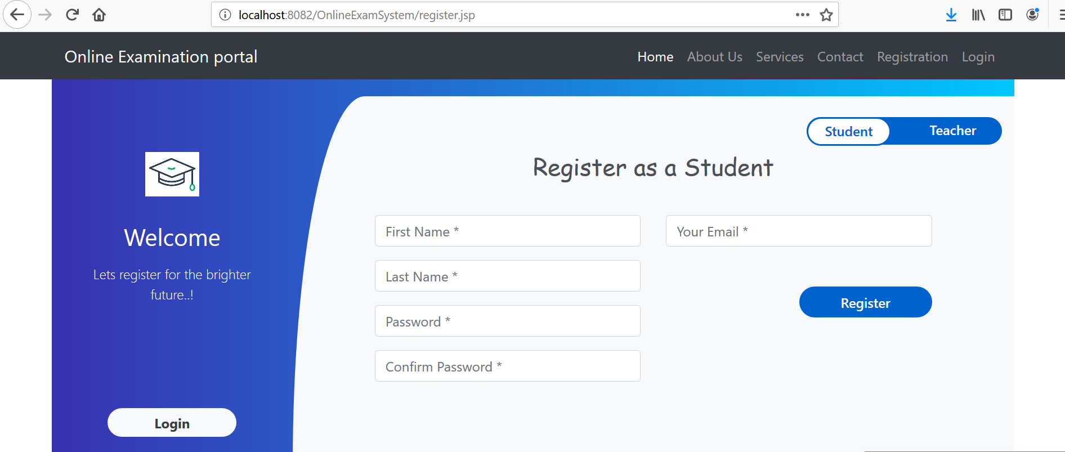
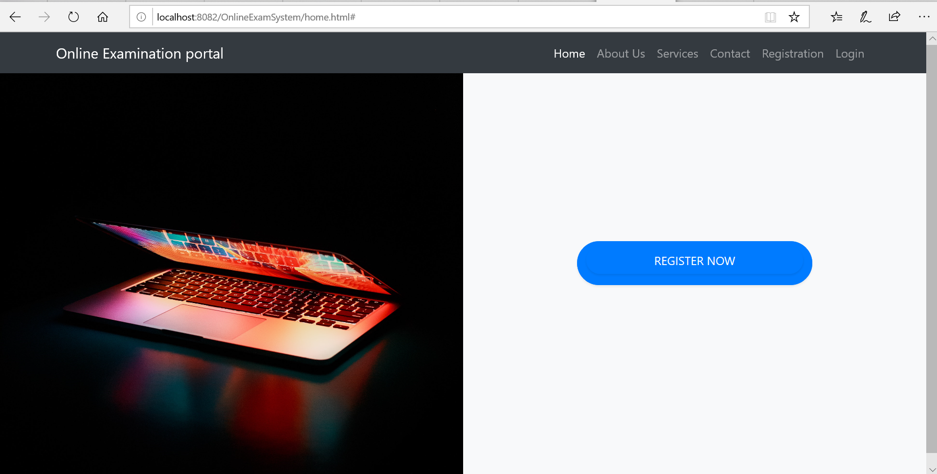
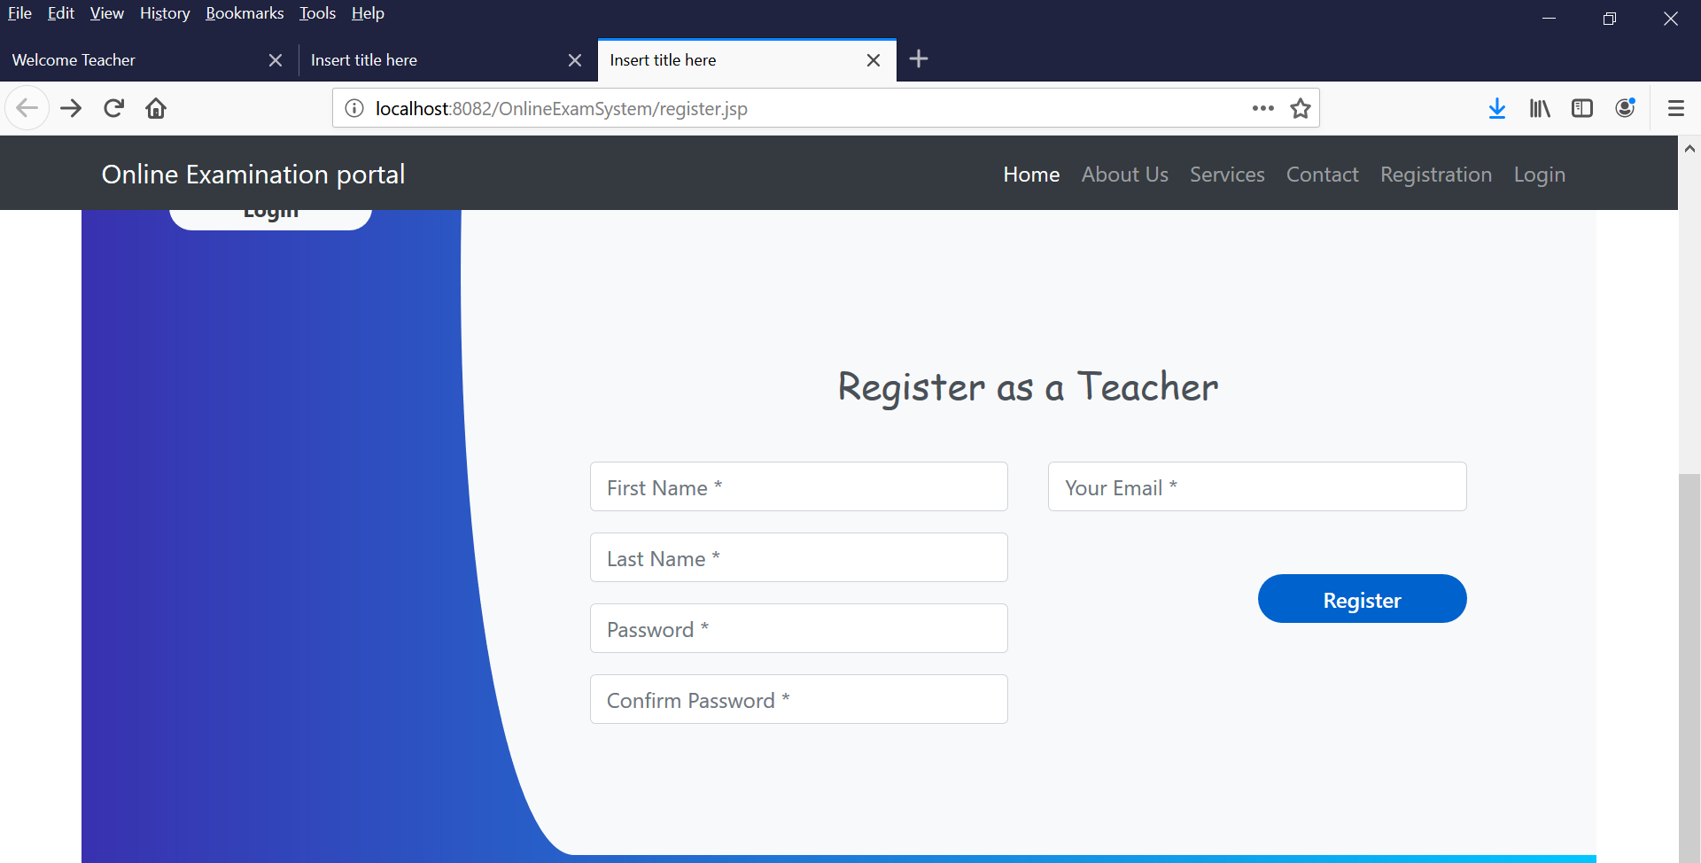
Navigation Bar and Registration Page
a
a

Slide 5
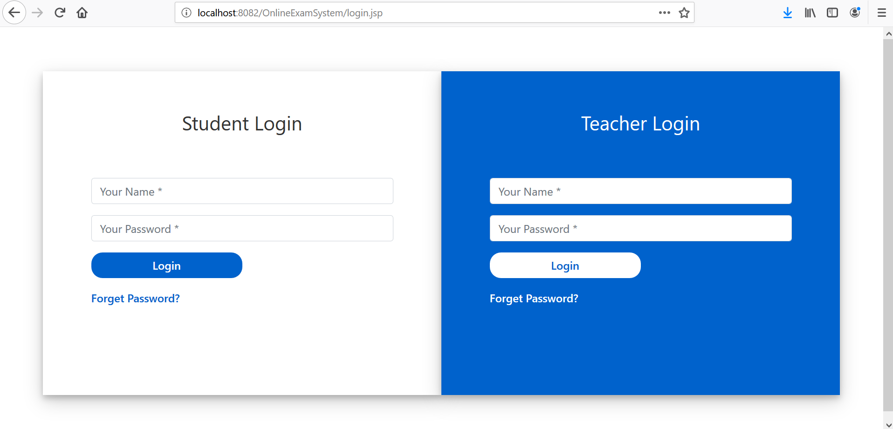
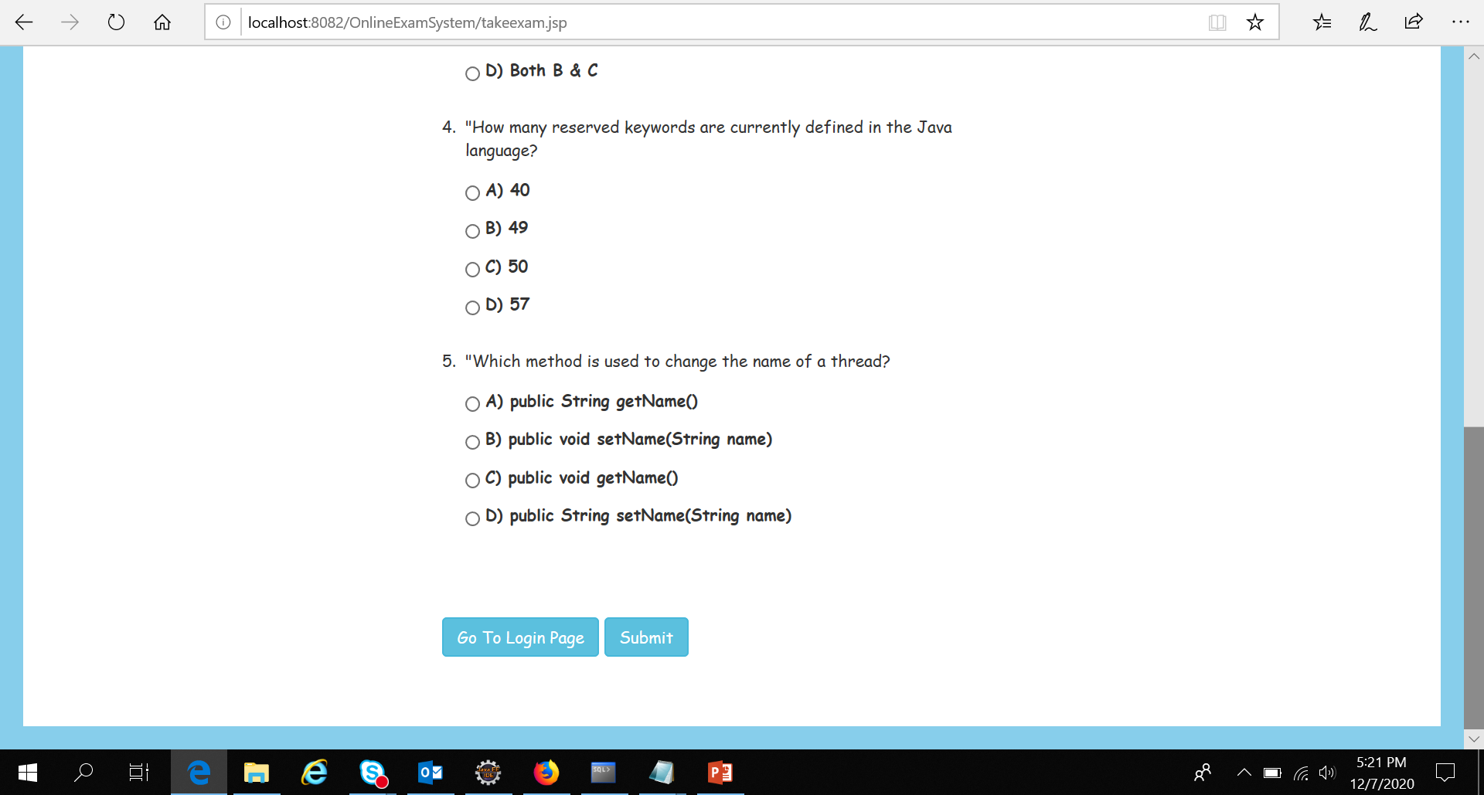
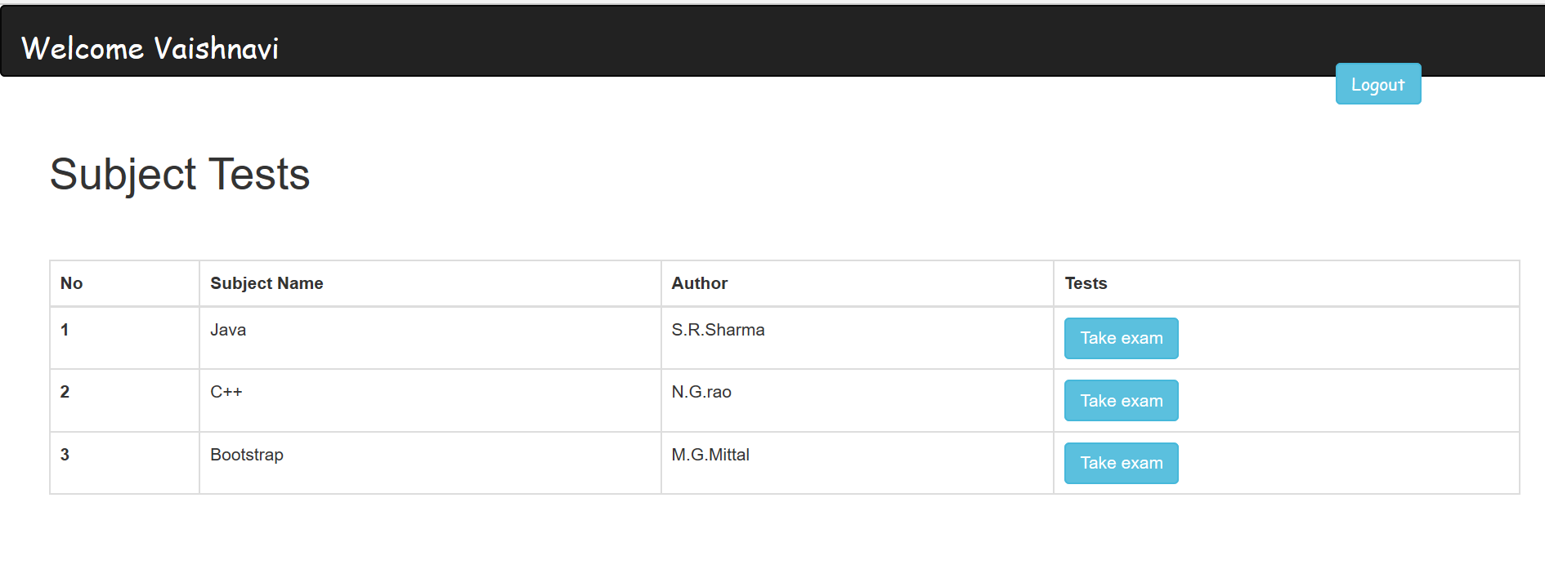
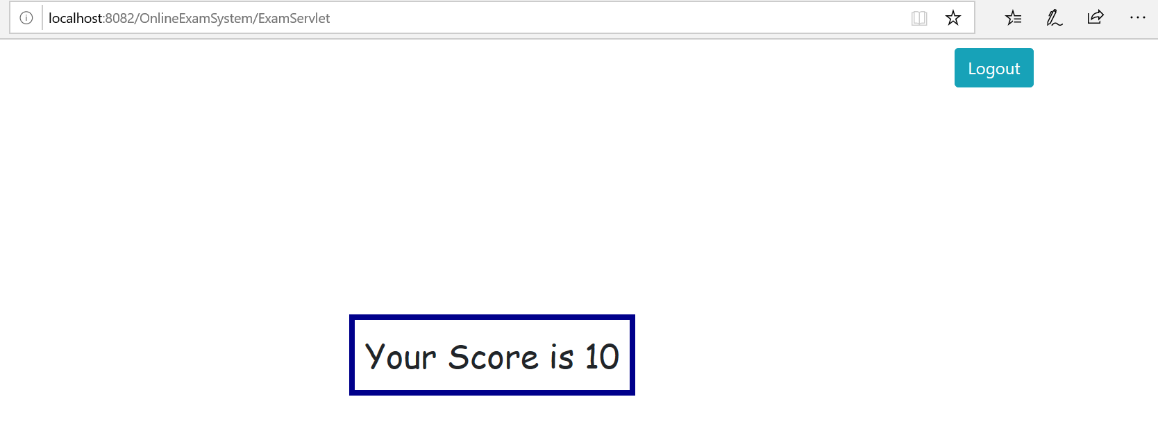
After Student Login and Test Attempt

Slide 6
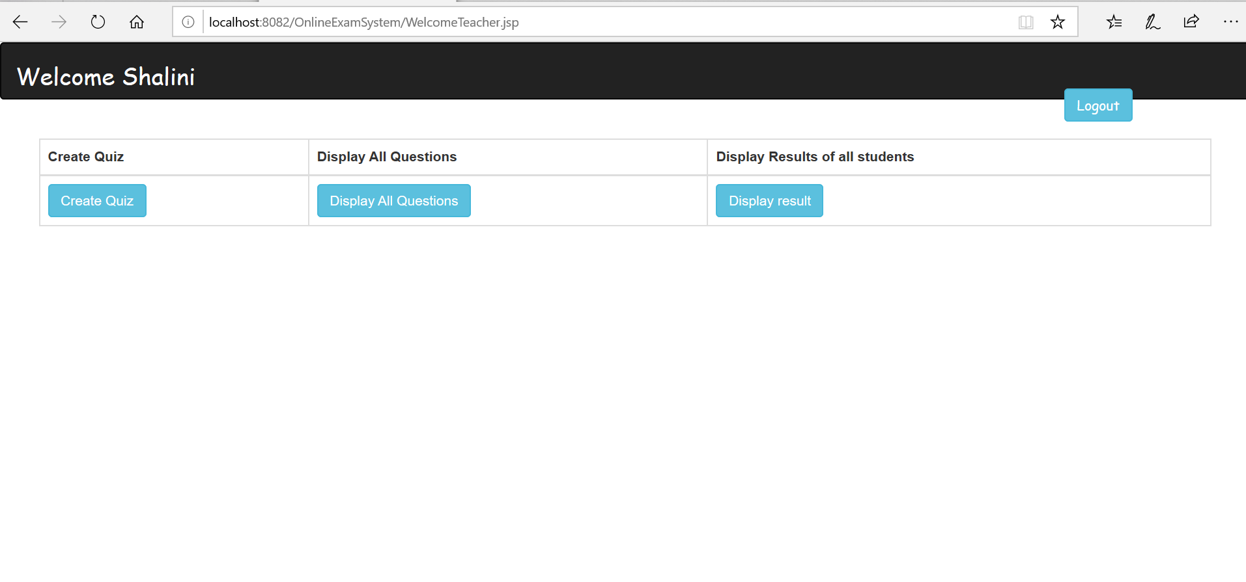
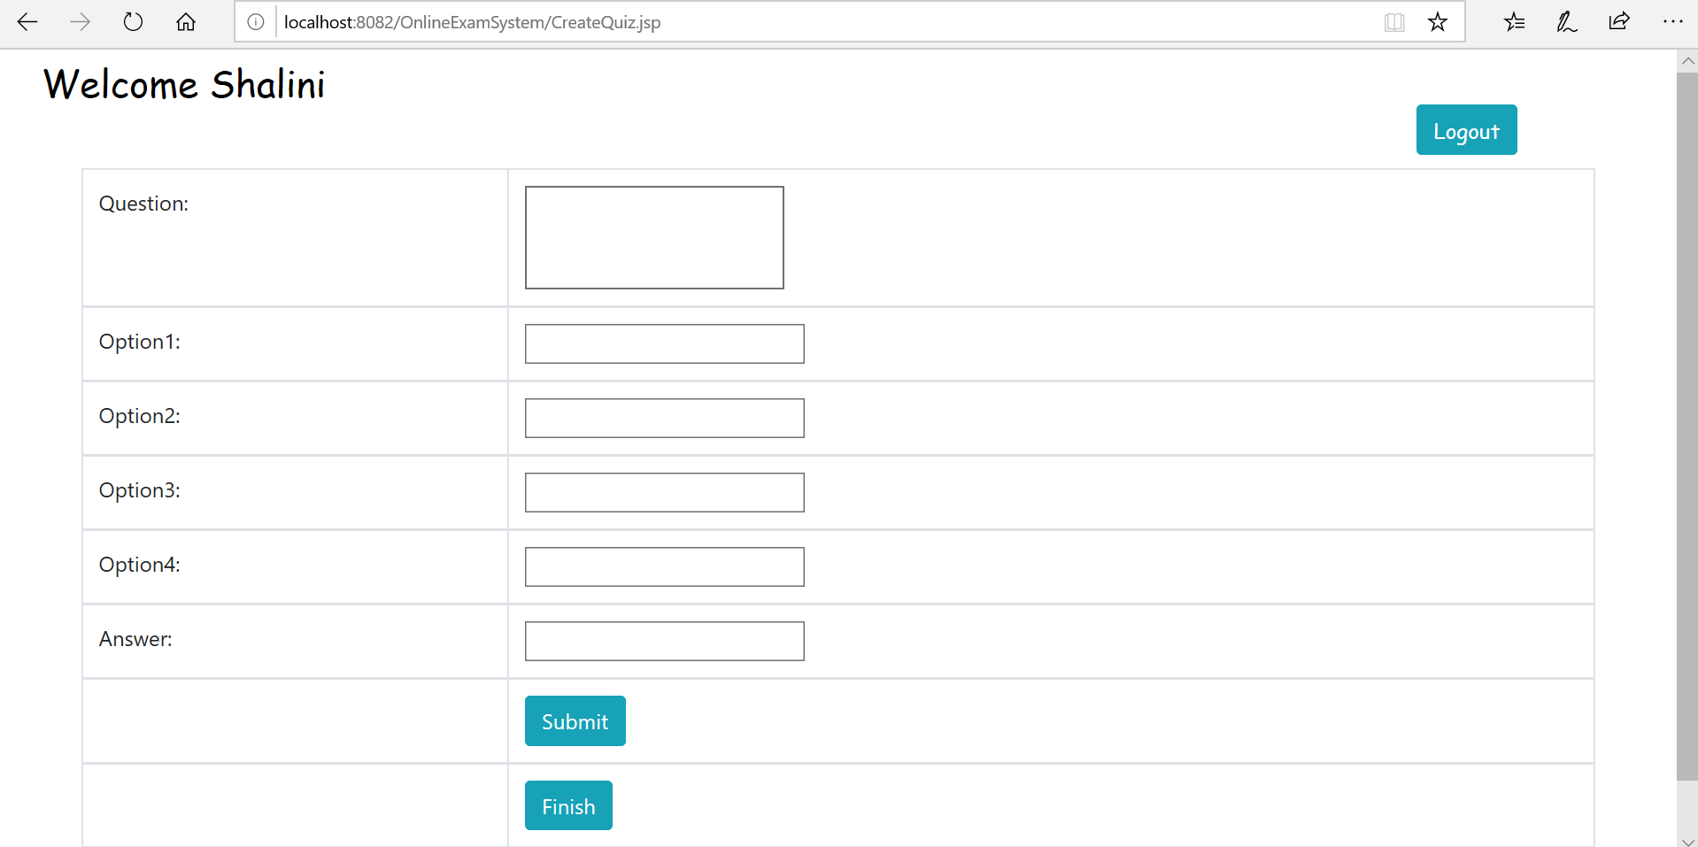
After Teacher Login

Slide 7
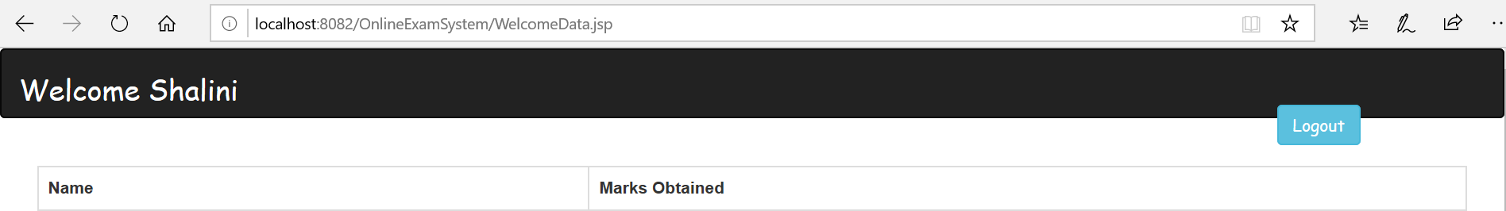
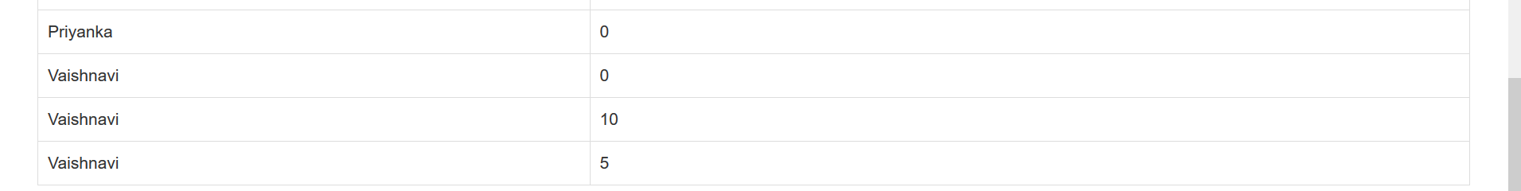
Display Marks Data

Slide 8
Thank you

